Slide 1




Deakin University
Information available in audio.
FTP PROGRESS
PRESENTED TO
Prof. Gang Li
PRESENTED BY
Gaurang Gupta
Tourism Demand Forecasting
18 5 2024

Slide 2

DEAKIN UNIVERSITY
Implemented CNN LSTM
and Conv LSTM on newer Dataset
Progress
1
2
Researched on New Methods

Slide 3
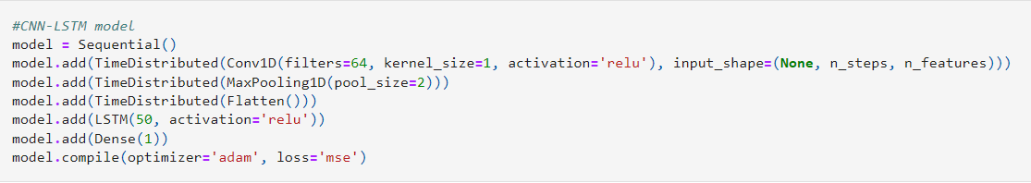
CNN LSTM
The CNN-LSTM model combines Convolutional Neural Networks (CNN) and Long Short-Term Memory (LSTM) networks to leverage the strengths of both architectures for time series forecasting.

Slide 4
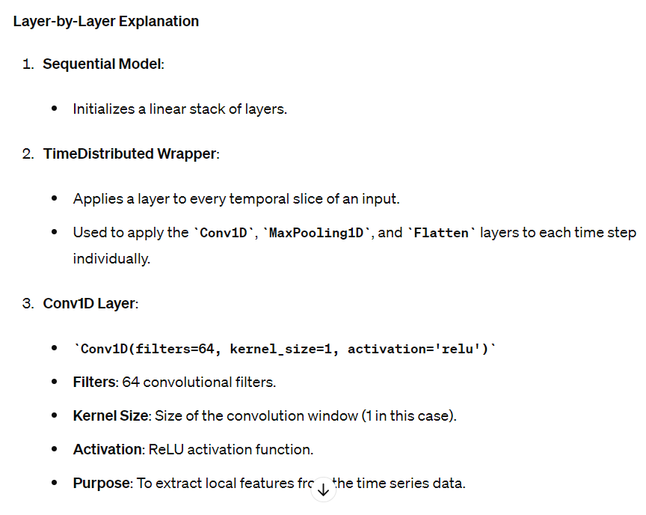

Slide 5
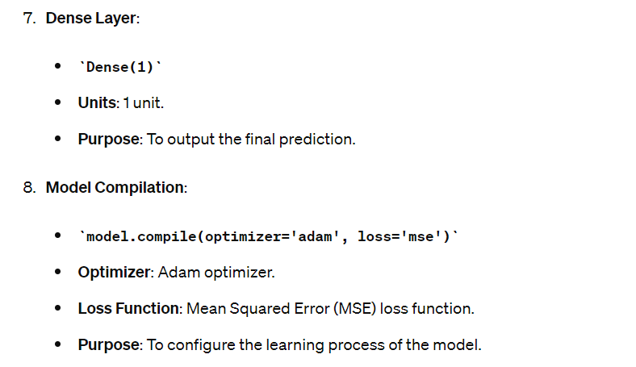

Slide 6
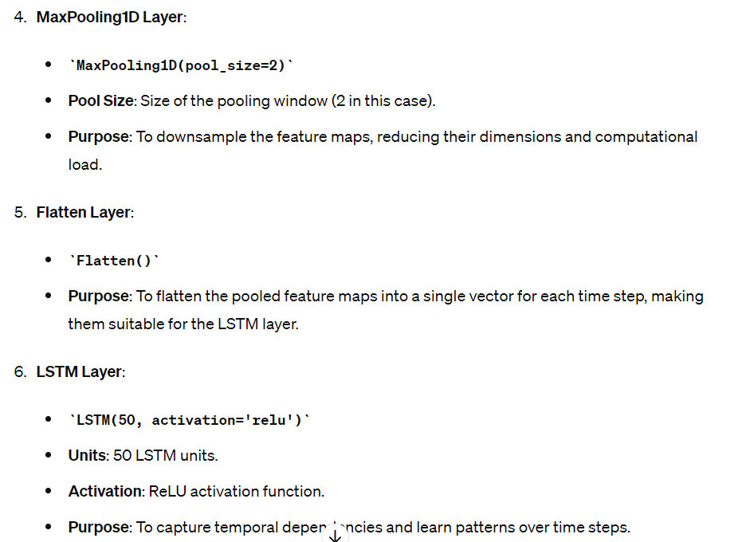

Slide 7
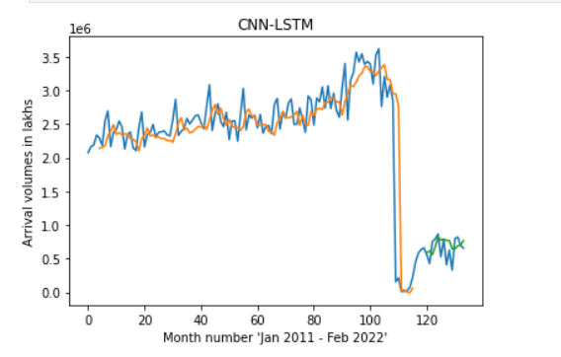

Slide 8



Slide 9





Slide 10
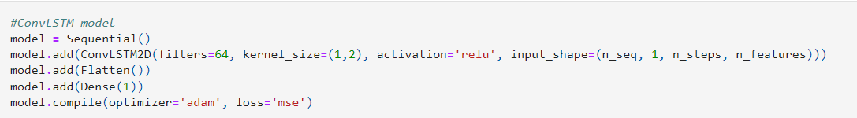
ConvLSTM
The ConvLSTM model integrates convolutional operations directly into the LSTM architecture, allowing it to capture both spatial and temporal dependencies.

Slide 11
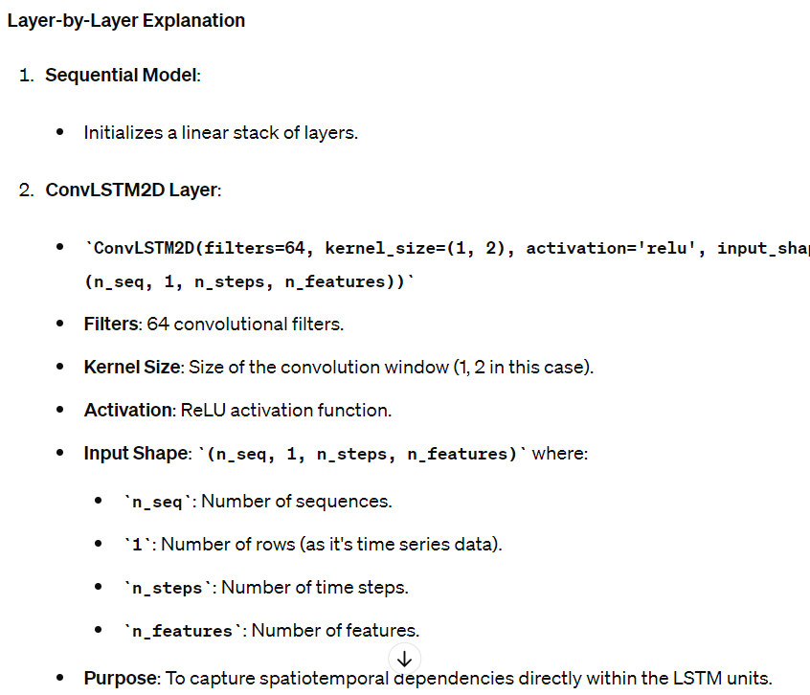

Slide 12
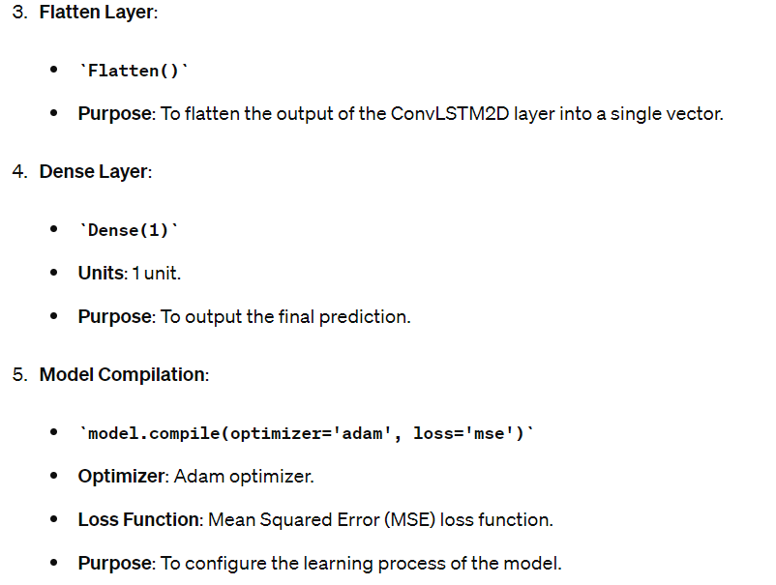

Slide 13
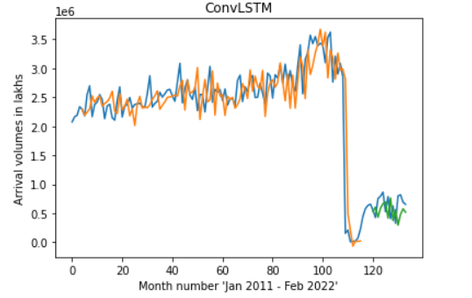

Slide 14




Slide 15





Slide 16
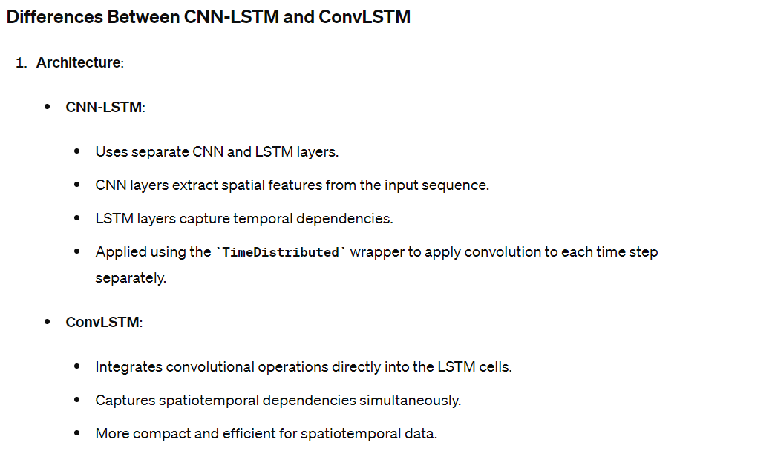

Slide 17
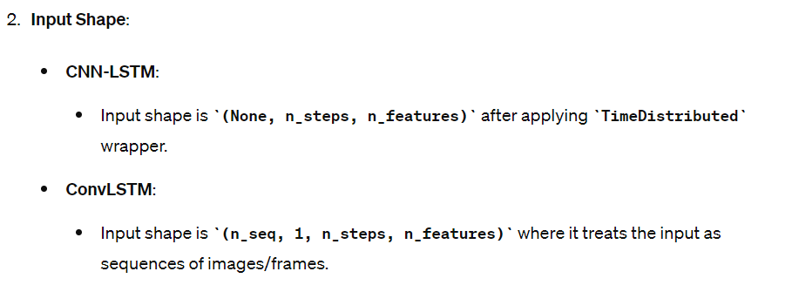
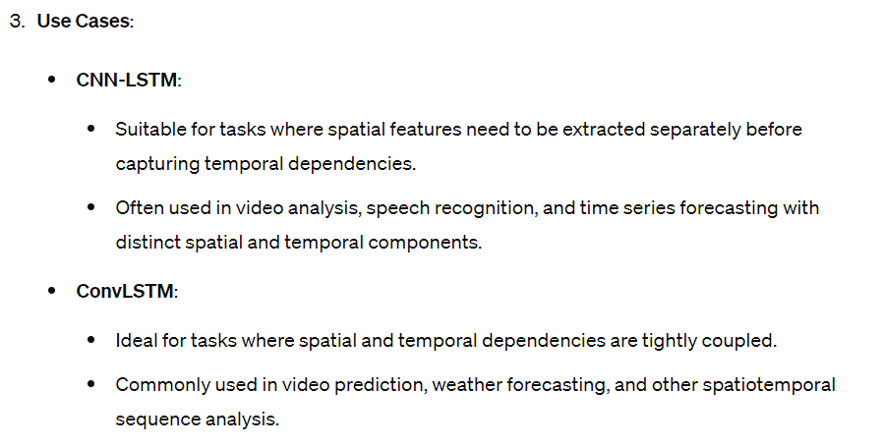

Slide 18
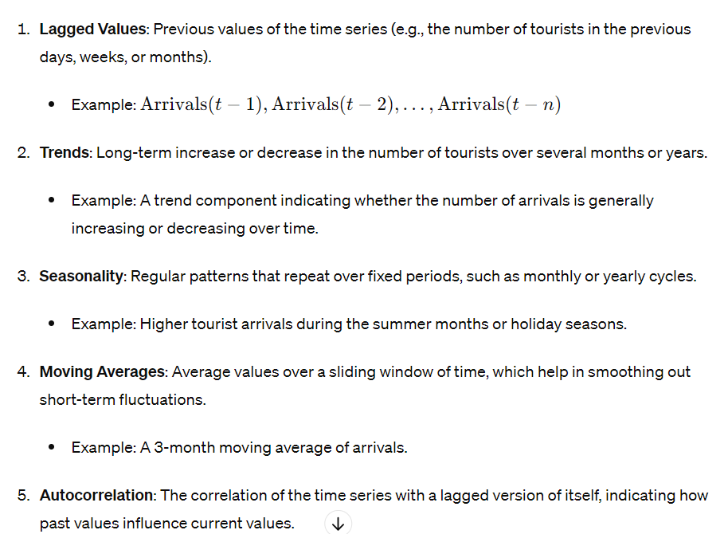
Temporal Features
Temporal features refer to the aspects of the data that relate to time and how values change over time. In time series forecasting, capturing temporal features is crucial because it helps the model understand patterns, trends, and seasonality in the data.

Slide 19
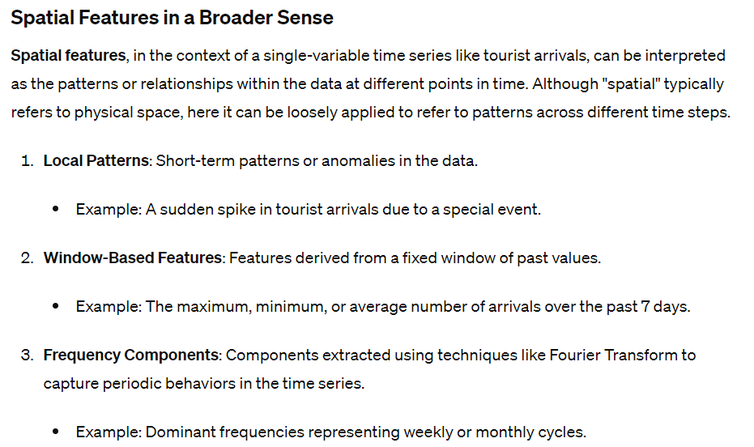

Slide 20
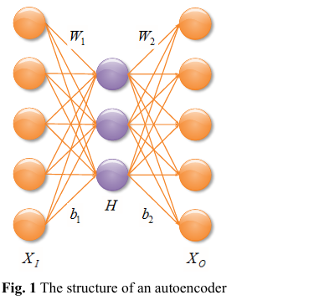
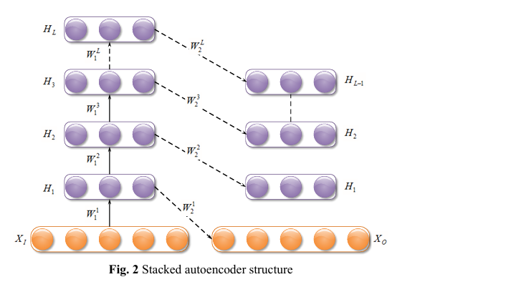
B SAKE Model

Slide 21
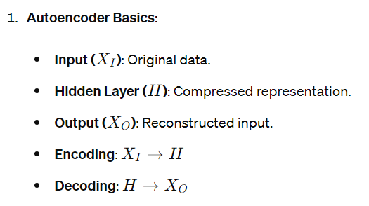

Slide 22
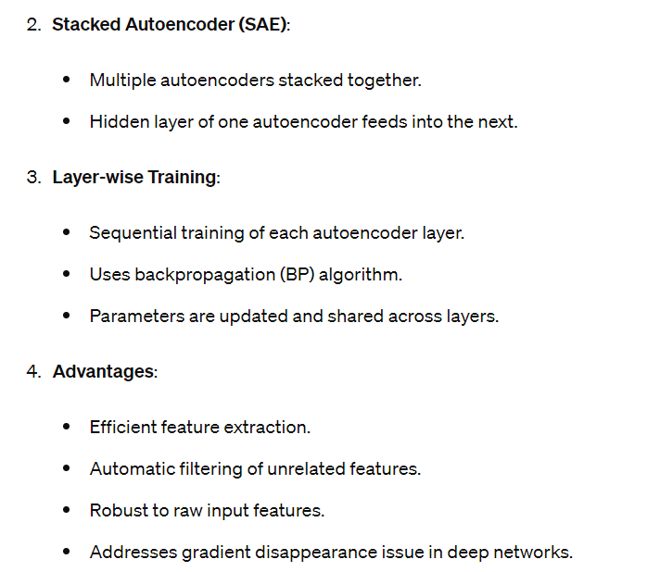

Slide 23
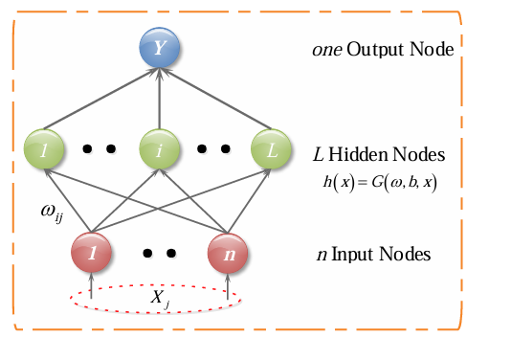
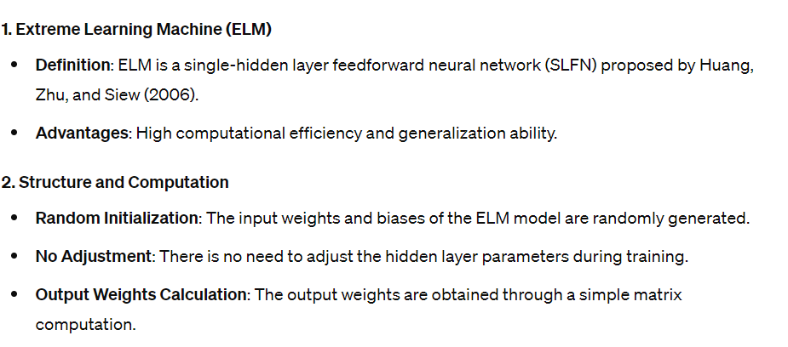
KERNEL EXTREME LEARNING MACHINE

Slide 24
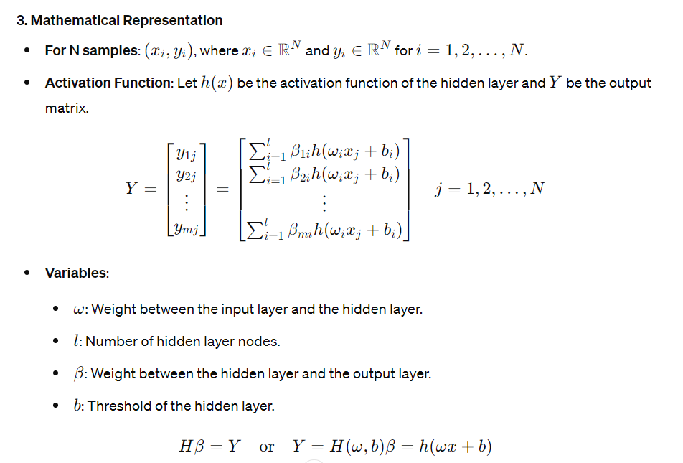

Slide 25
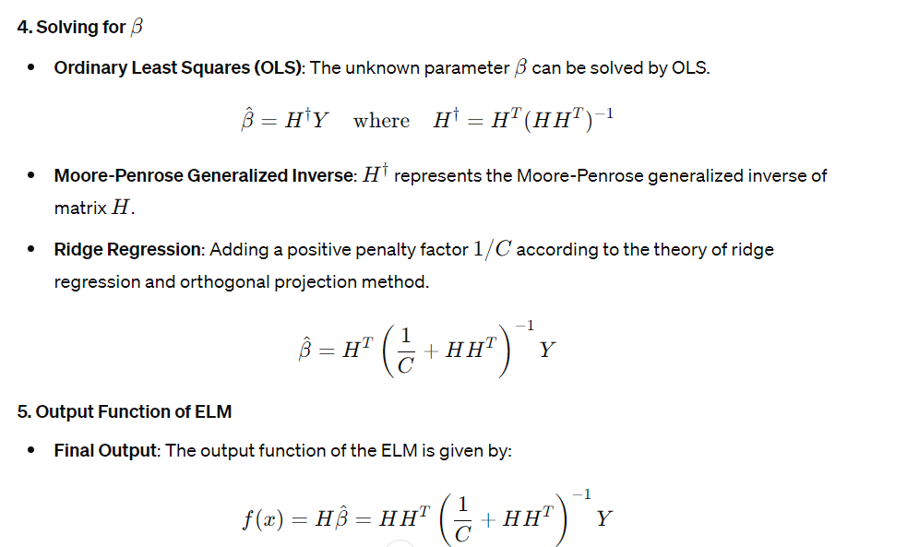

Slide 26
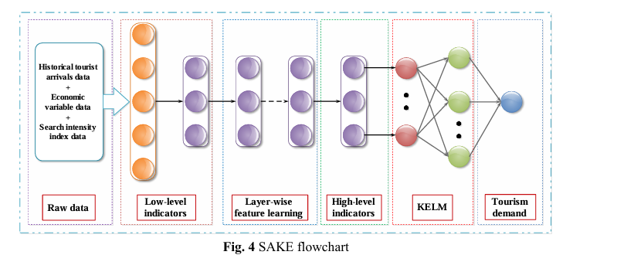

Slide 27
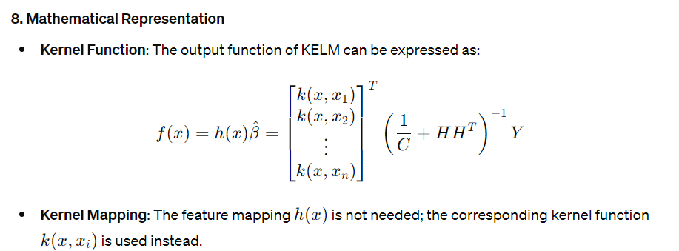

Slide 28
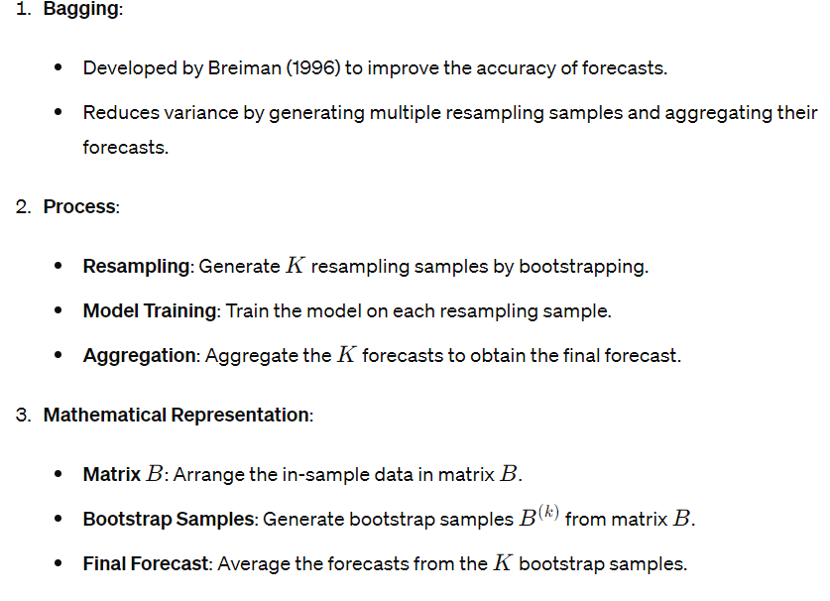
Bagging

Slide 29
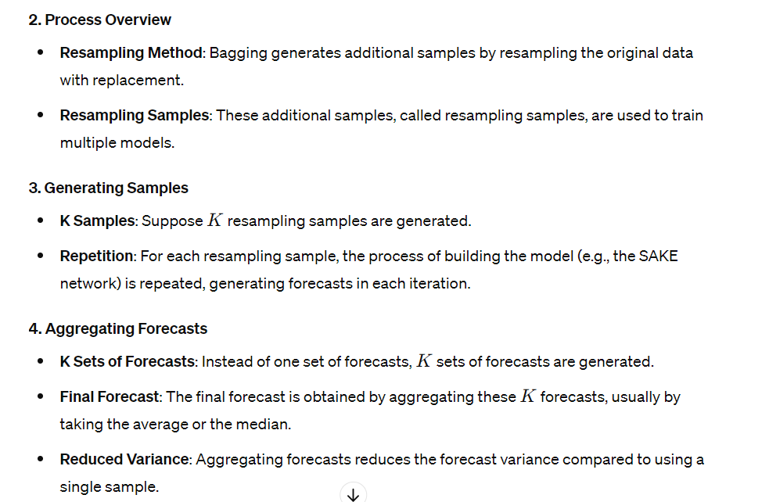

Slide 30
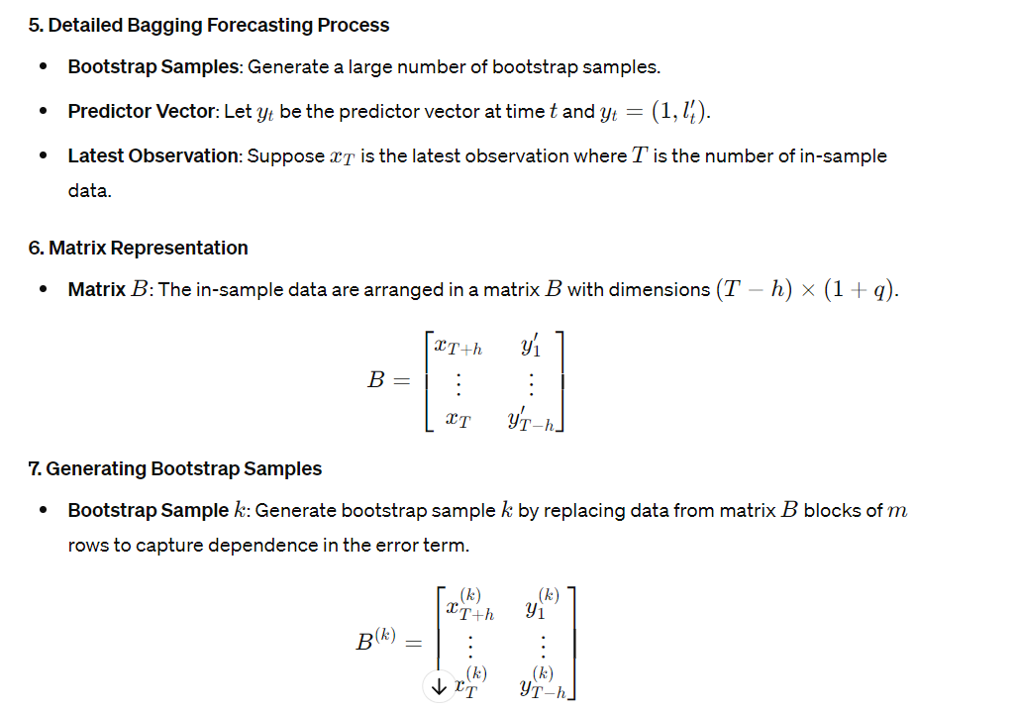

Slide 31
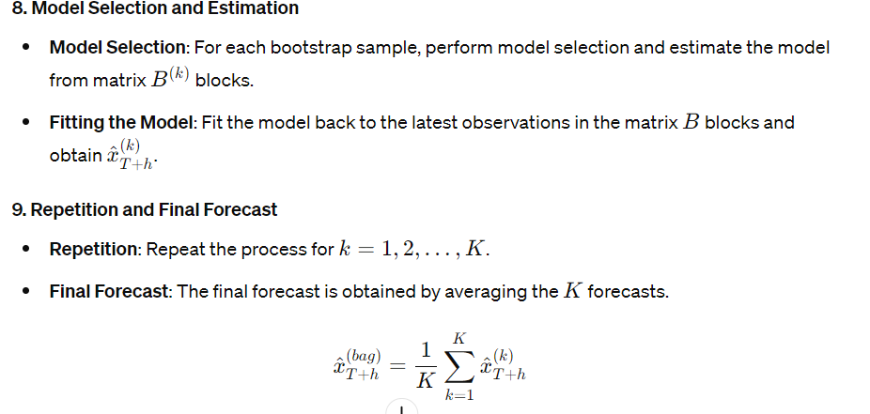

Slide 32
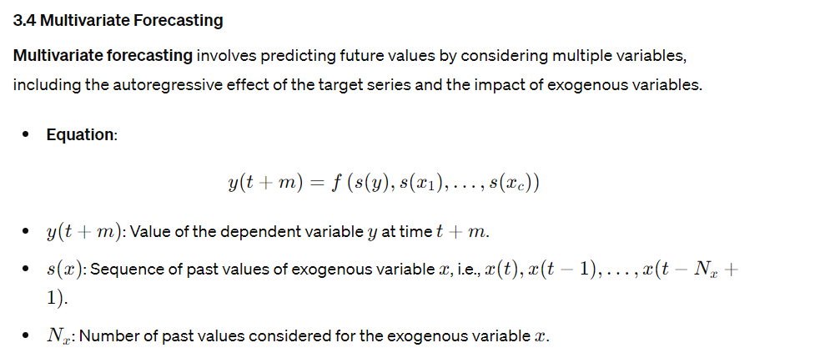

Slide 33
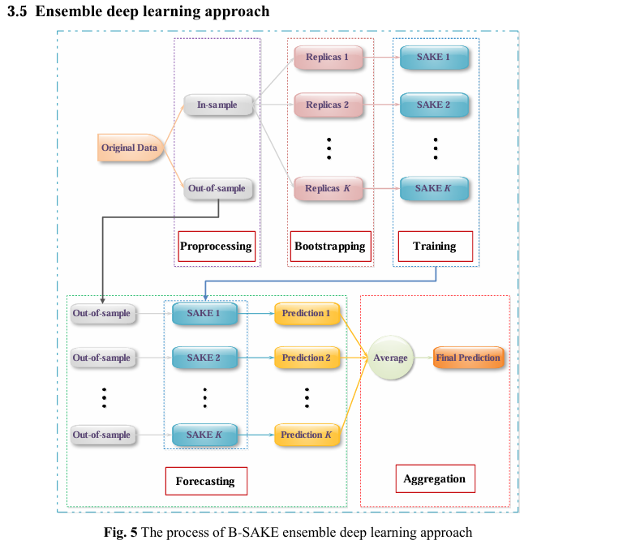

Slide 34
